Slide 1

Mobile Game Development
By Wijanarko Sukma

Slide 2
About Me
C++ and C# Programmer
ex-Technical Director and Lead Game Programmer at Alkemis Games
Raiders Quest RPG
Power Spheres by BoBoiBoy
ex-Game Programmer at Studio Selamat Pagi
Berangkat! Street Food
ex-Embedded System Programmer at Infoglobal

Slide 3
Introduction

Slide 4
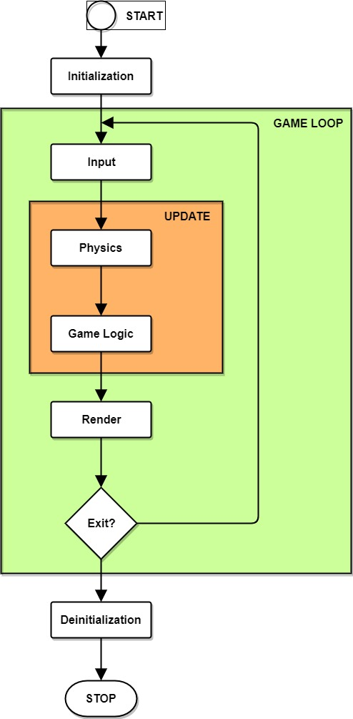
Game Development
Game loop
Update timestep
Variable timestep
Fixed timestep
Game logic

Slide 5
Mobile Game Development
Screen resolution (https://v-play.net/doc/vplay-different-screen-sizes/)
Touch input (multi-touch)
Sensors
Accelerometer
Gyrometer
Phone Camera
etc.

Slide 6



Game Engine

Slide 8
Cocos2d-x
Cross-platform Game Engine
Written in Modern C++ with extension to lua and JS
Open source with MIT license
One code to rule them all
Works on iOS, Android, OS X, Windows, Linux and Web platforms

Slide 9
History
2008, Ricardo Quesada in Argentina created Cocos2d
Shortly after, Cocos2d ported to Objective-C with the opening of Apple App Store
2010, Zhe Wang in China forked Cocos2d and created Cocos2d-x which adopted Objective-C aspects such as Automatic Reference Counting
2013, Ricardo Quesada joined Cocos2d-x team
Now Cocos2d-x version 3.16 has been released

Slide 10







Target Platforms

Slide 11
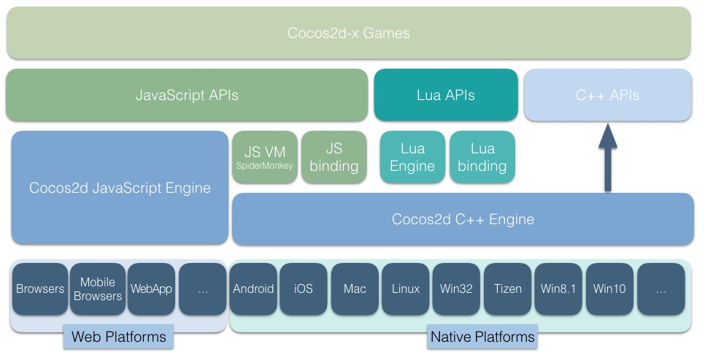
Architecture

Slide 12
General Requirements
Cocos2d-x (https://github.com/cocos2d/cocos2d-x)
Python 2.7.5 (download)
Apache ANT (download)

Slide 13
Windows Platform Req.
Windows 7+
Visual Studio 2015+

Slide 14
iOS and OS X Platform Req.
MacOS X 10.7+
Xcode 8+

Slide 15
Android Platform Req.
Any OS
Android Studio
Android SDK
Android NDK r16+
JRE or JDK 1.6+

Slide 16
Linux Platform Req.
Ubuntu 12.10+
CMake 2.6+

Slide 17
Games using Cocos2d-x

Slide 18

Raiders Quest
Alkemis Games

Slide 19

Avengers Alliance
Marvel Entertainment

Slide 20

BADLAND
Frogmind

Slide 21

Brave Frontier
Gumi

Slide 22

Final Fantasy: Record Keeper
DeNA Co., Ltd.

Slide 23
Installation

Slide 24
Download
http://www.cocos2d-x.org/download
Under the column, Cocos2d-x
Click, “Download 3.16”
Unzip it
Or download the source from github
https://github.com/cocos2d/cocos2d-x

Slide 25
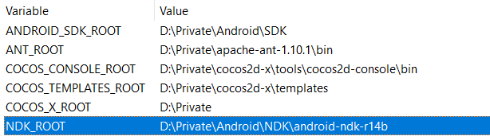
Environment Variables
ANDROID_SDK_ROOT: path to Android SDK directory
NDK_ROOT: path to Android NDK directory
ANT_ROOT: path to Apache Ant binary

Slide 26
Setup
Open command line or terminal
Go to Cocos2d-x root directory
Run setup.py using python
Will modify the path and other environment variables

Slide 27
Basic Concepts

Slide 28

Director
Viewport
FPS
Scenes Flow
Camera
Game Loop

Slide 29
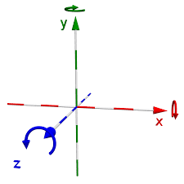
Right-handed Coordinate
System
Origin (0, 0) is located at bottom left screen
X position increases to the right
Y position increases to the top
Z position increases to the front
Counter-clockwise rotation

Slide 30
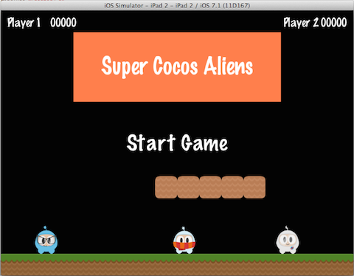
Scene and Scene Graph

Slide 31
Node Object
Object instantiated using cocos create function
Implements Automatic Reference Counting
i.e. Scene, Layer, Sprite, Widget, etc.

Slide 32
2D Graphics
Sprites and Spritesheets
Texts
Transition between scenes
Special effects
Particle system
Parallax scrolling
Tilemap supports:
Orthogonal
Isometric
Hexagonal

Slide 33



2D Animation
Spritesheet animation
Skeletal animation:

Slide 34
Event Dispatcher
Mechanism to respond at user events
The basics:
Event objects: contain information about the user event
Event listeners: encapsulate your event processing code
Event dispatcher: notifies listeners of user events
i.e. Touch event, Keyboard event, Custom event, etc.

Slide 35
Audio
Background music
Sound effects
Supported audio files are platform dependent

Slide 36


Physics
Notes:
Chipmunk2D
Portable 2-dimensional real-time rigid body physics engine
Box2D
Free open source 2-dimensional physics simulation engine

Slide 37
Network
WebSocket API
HTTP Request
HTTP + SSL

Slide 38





User Input

Slide 39
Starting Up

Slide 40
Cocos Command Options
new - creates a new game project
compile - compiles the game
deploy - deploy game to target
run - compile, deploy and run the game on target
luacompile - minifies lua files and compiles
jscompile - minifies JS files and compiles

Slide 41
Create Project
Open command line / terminal
“cocos new -l cpp -p com.wiwing.ponggame Pong-Game”

Slide 42
Command Explained
Pong-Game: name of the game
-l cpp: selected language for the game, valid values are cpp, js and lua
-p com.wiwing.ponggame: chosen package name

Slide 43
Directory Structure
Classes
cocos2d
Resources
Platform directories

Slide 44
Starting Class
AppDelegate: initialize and configure the game
Viewport
FPS
First scene initialization
HelloWorldScene: starting scene

Slide 45
Adding Scenes
Create new scenes:
Main scene
Game scene with physics enabled

Slide 46
Main Scene
Add Title text and place it at the middle-top of the screen
Add Buttons:
Start button: place it at the middle of the screen
Exit button: place it at the middle of the screen

Slide 47
Game Scene
Add Two bars at the left and right corner of the screen
Add Ball image
Add Logics

Slide 48
Game Logic
Add scoring system
Add winning and losing condition

Slide 49
Repository
https://github.com/wijanarko-sukma/pong-game

Slide 50
Tips and Tricks

Slide 51
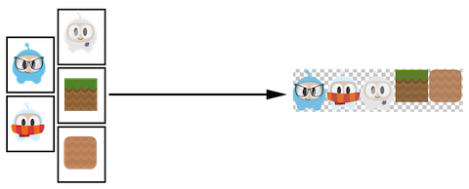
Spritesheet

Slide 52
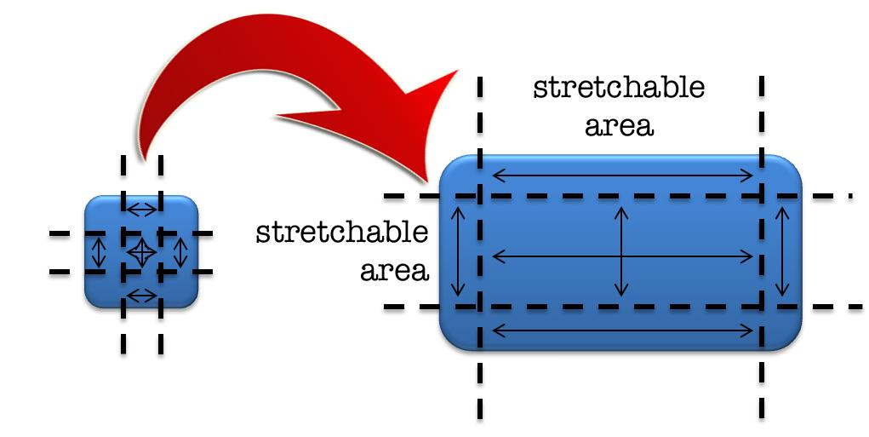
9-Slice

Slide 53
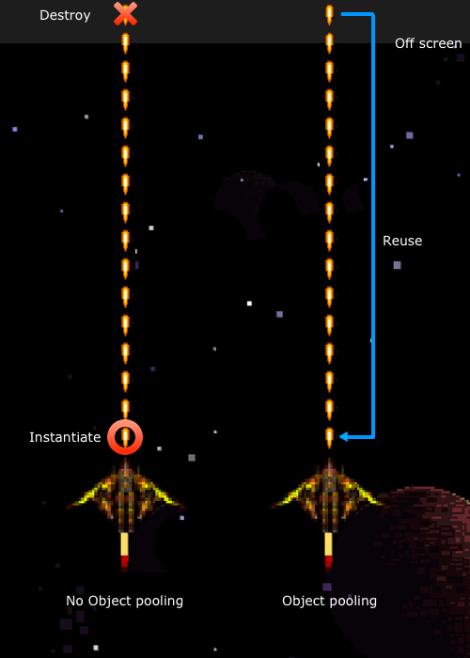
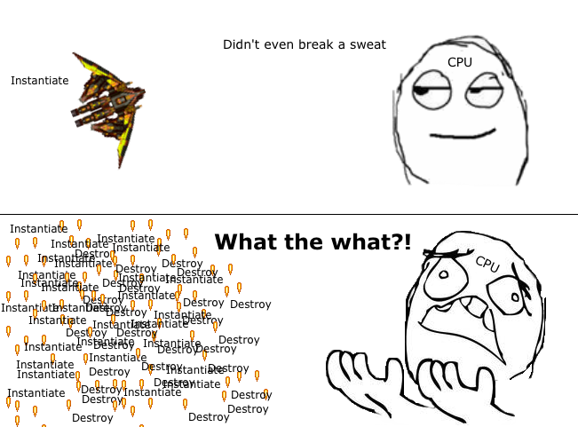
Object Pool

Slide 54
Entity Component System
Data-driven approach
“Composition over Inheritance”
Consists of:
Entity: identifier of an object (NO DATA AND LOGIC ALLOWED)
Component: data repository that compose an object (NO LOGIC ALLOWED)
System: handle specific logics for the objects

Slide 55
Community
http://discuss.cocos2d-x.org
Forums
Tutorial
Blog

Slide 56
References

Slide 57
http://cocos2d-x.org/
https://github.com/cocos2d/cocos2d-x/
http://cocos2d-x.org/docs/cocos2d-x/en/basic_concepts/
https://www.gamedev.net/articles/programming/general-and-gameplay-programming/the-entity-component-system-c-game-design-pattern-part-1-r4803/

Slide 58
Q & A

Slide 59
Thank You

